Slide 1

Santander Customer Transaction Prediction 2nd Place Solution
Kazuki Onodera, Kei Harada, Takuya Akiyama Data Science Gr. AI System Dept.

Slide 2
Agenda
1
Basics
2
Solution
3
Interesting Findings

Slide 3
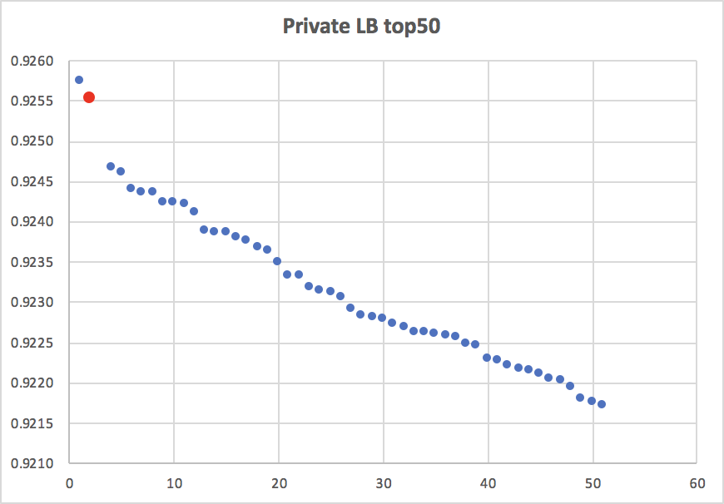
Basics
1
Public LB: 0.92653
Private LB: 0.92552
Total teams: 8,802
Number of team: 3
Entries: 45

Slide 4
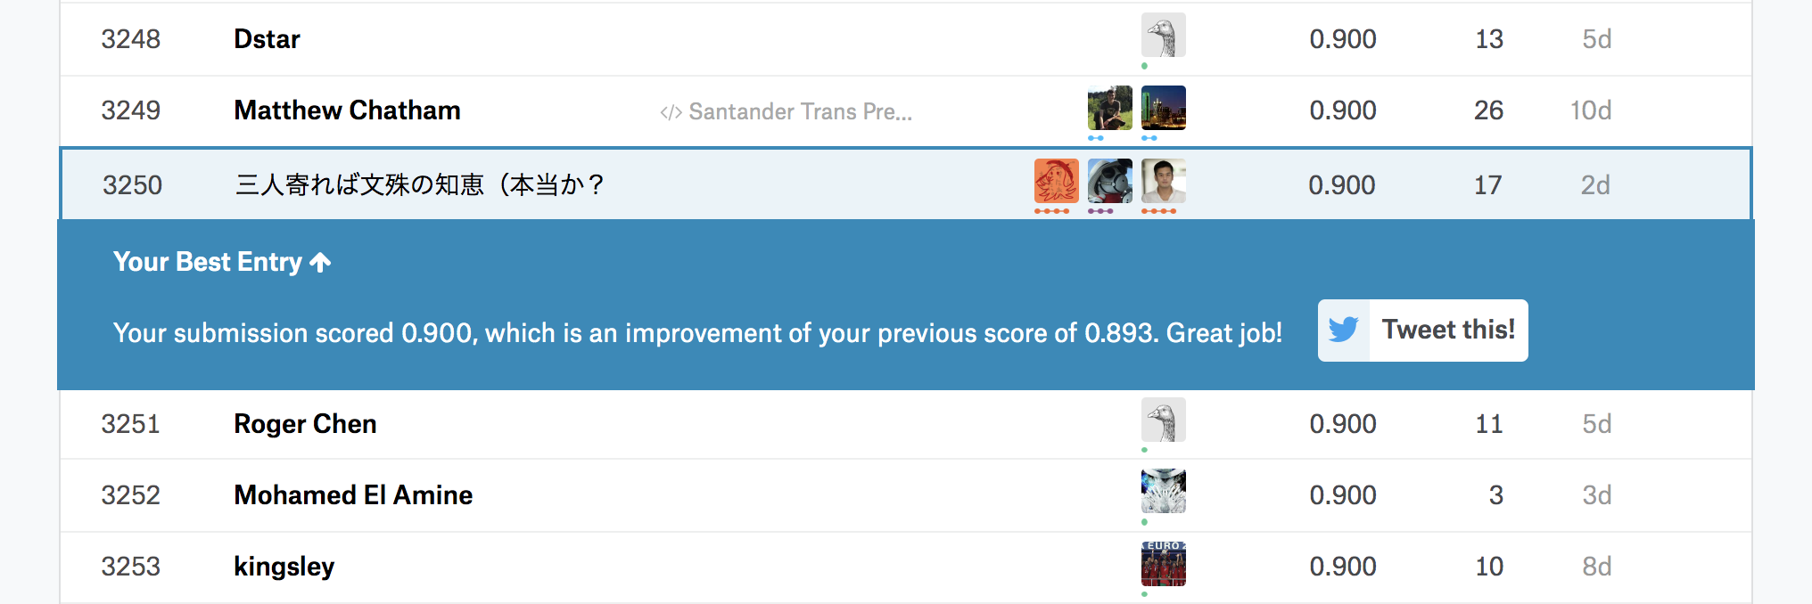
Basics
1
How to team up
We are colleagues at DeNA. But we really didn’t have any hunch for this competition at beginnings. Before one and half of week from deadline, we were 3250th.
So I(@ONODERA) named this team ‘三人寄れば文殊の知恵（本当か？’.
It means ‘3 heads are same as Monju(Is it true?’. Monju is god of wisdom.

Slide 5
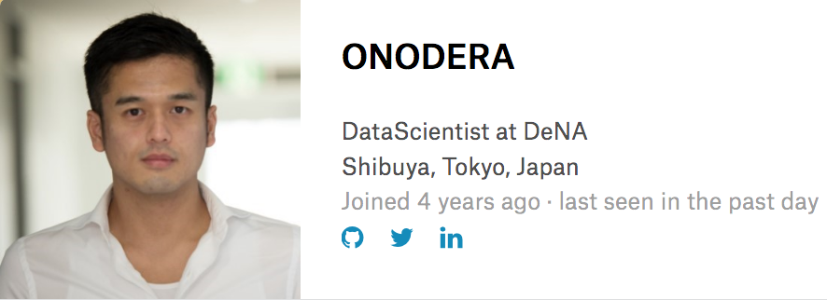

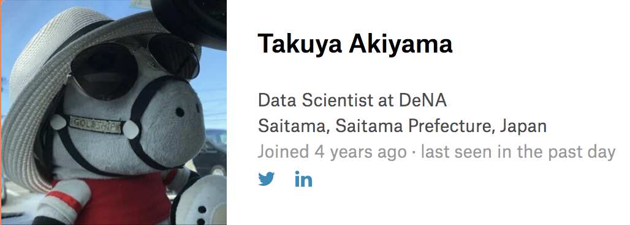
Basics
1
Introduce ourselves
ONODERA
2nd Place Junkie
hoxosh
Santa Master
Takuya Akiyama
ex-Expert Farm Owner

Slide 6
2
Solution
As we shared this thread, our solution is quite simple(also shared golf)
remove fake from test
concat train and test, and then reverse half of features
standard scaling
count encoding
count round encoding
unpivot all vars(so we have 200k x 200 = 4m train samples)
train and predict(LGB and NN)
convert prediction(200k x 200) into odds. We used (9 * p / (1 - p)).
blend LGB:NN = 1:3

Slide 7
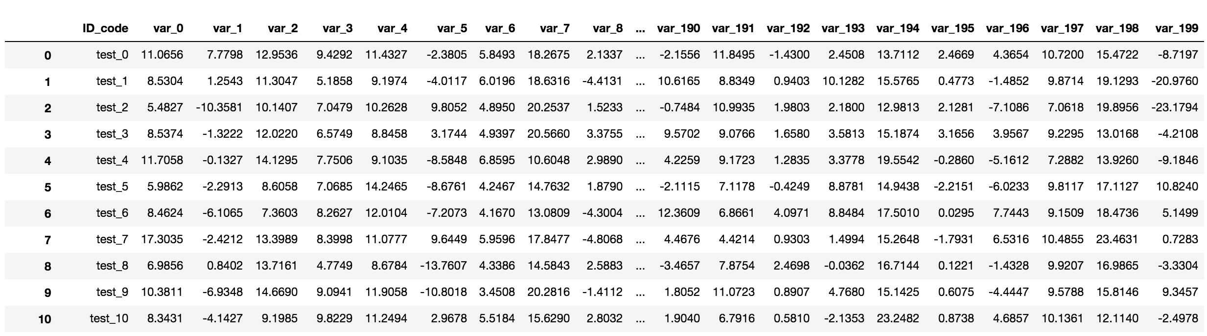
2
Solution
remove fake from test
According to this kernel, we do know which sample is fake exactly.
remove

Slide 8
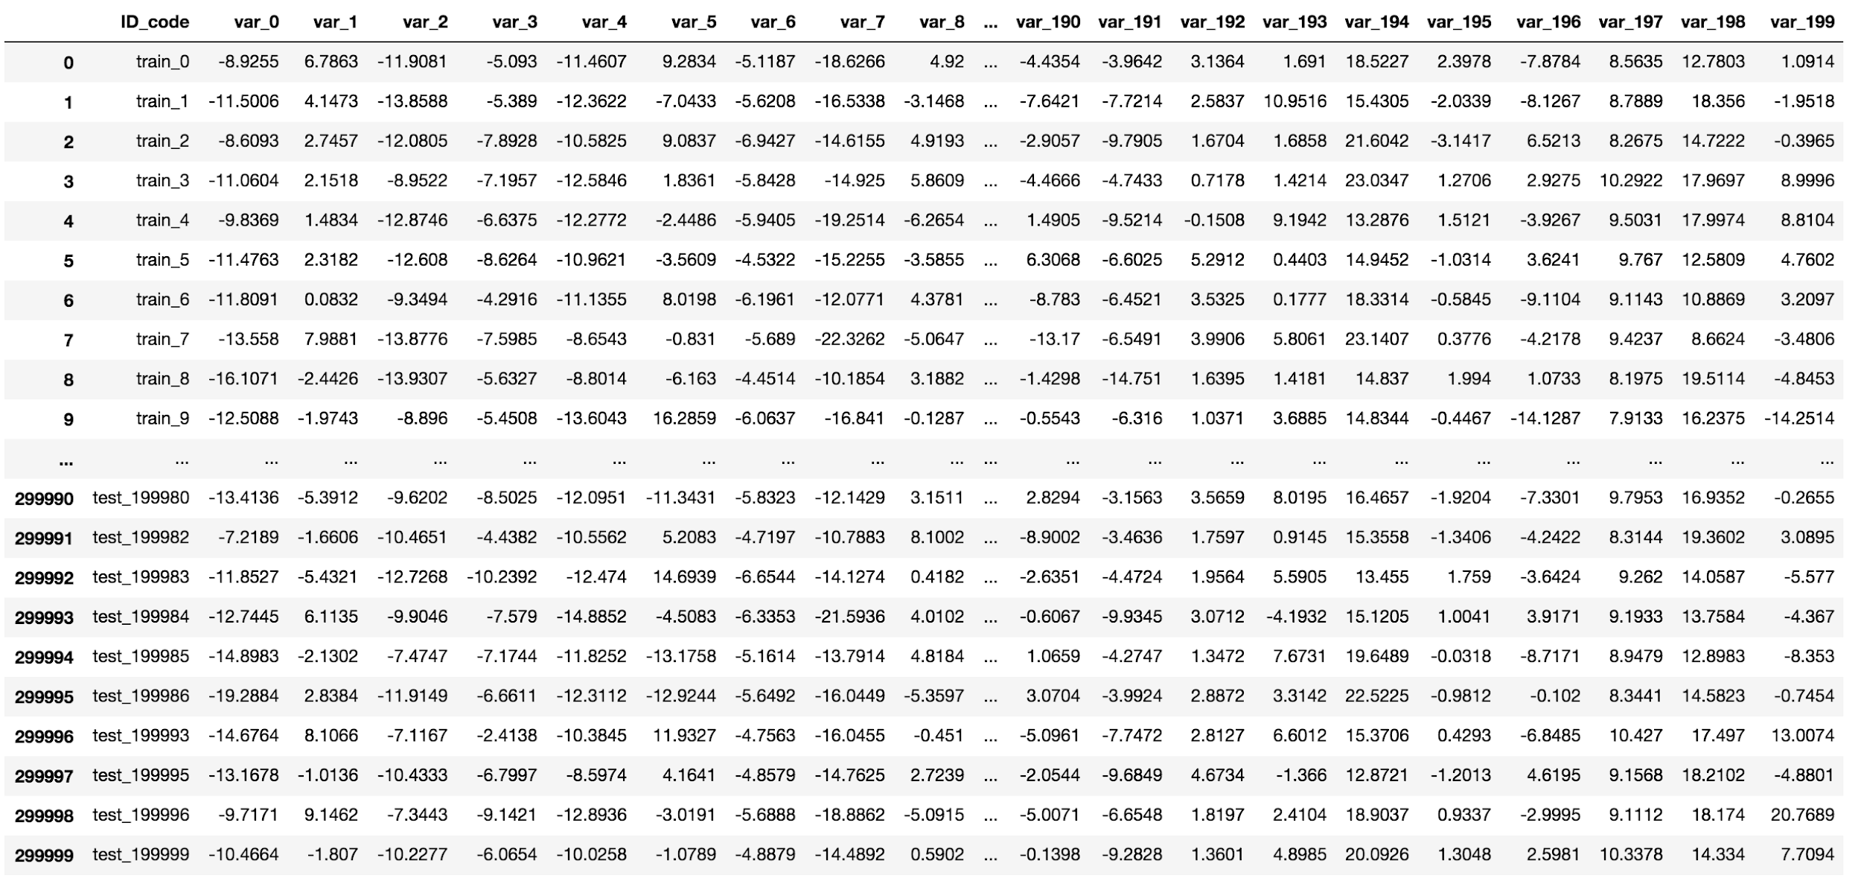
(more specific)
2
Solution
concat train and test, and then reverse half of features
refer to this kernel

Slide 9
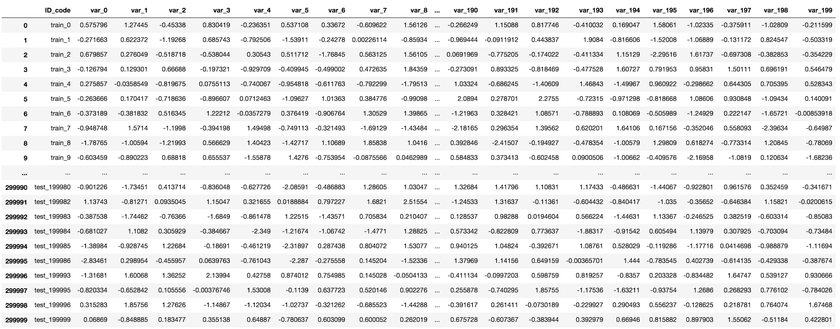
(more specific)
2
Solution
standard scaling

Slide 10
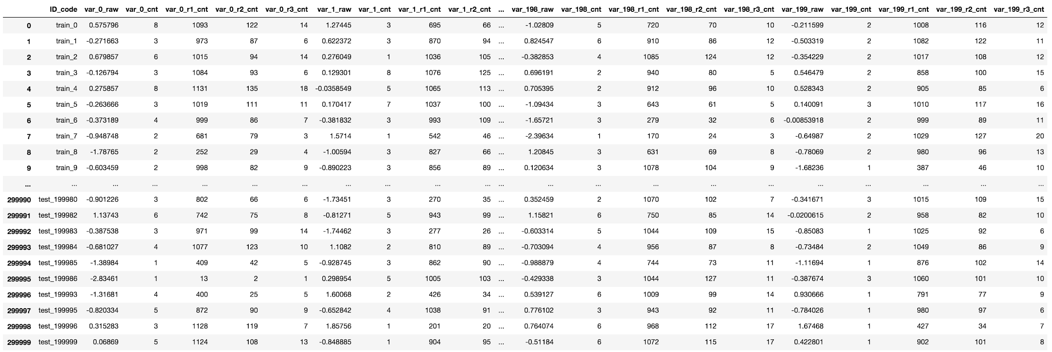
(more specific)
2
Solution
count encoding
count round encoding

Slide 11
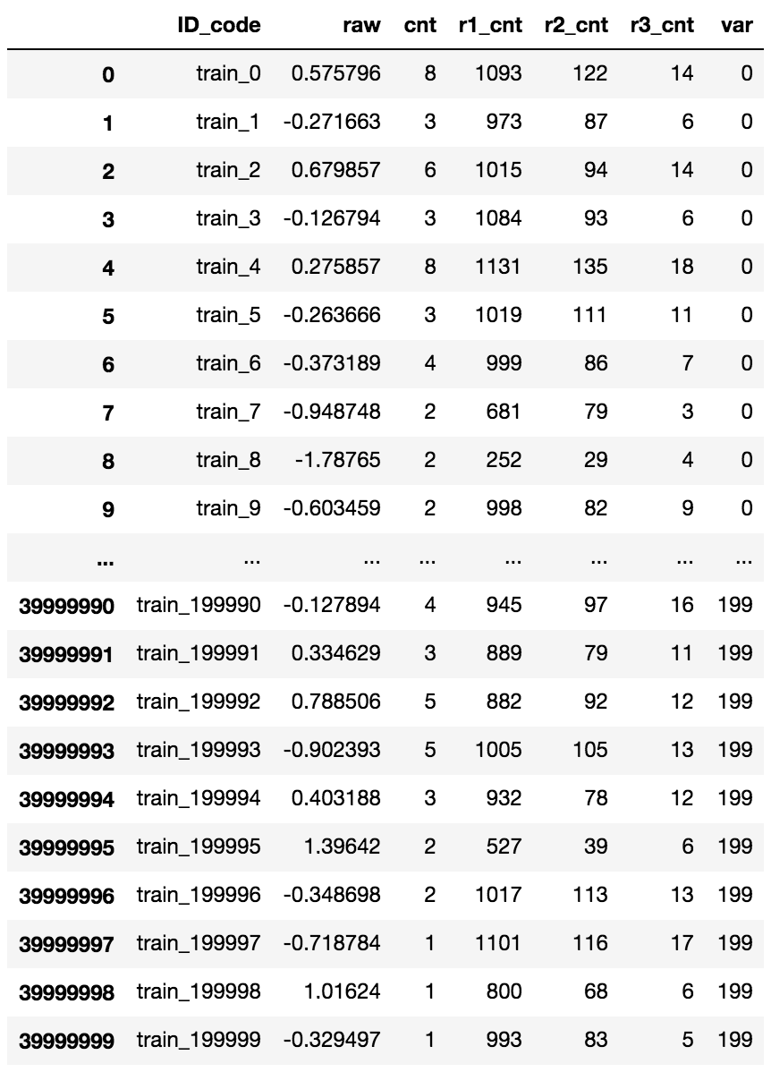
2
Solution
(more specific)
unpivot all vars(so we have 200k x 200 = 4m train samples)

Slide 12
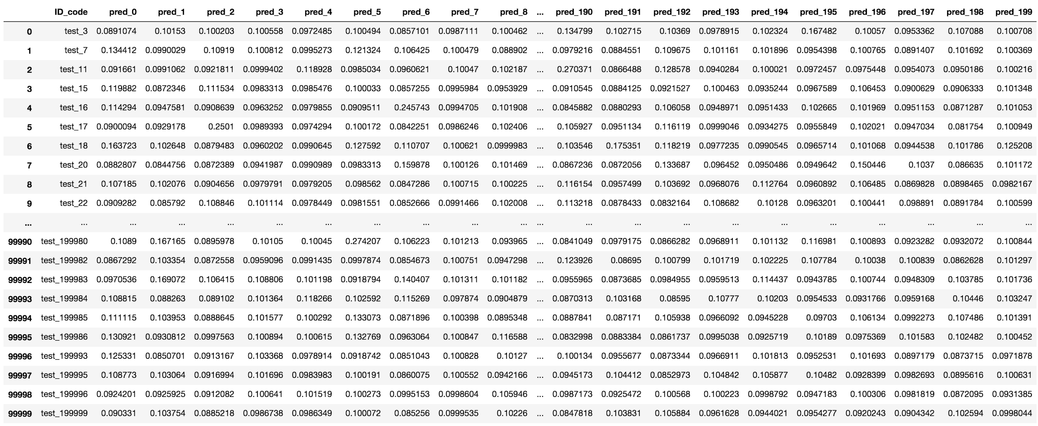
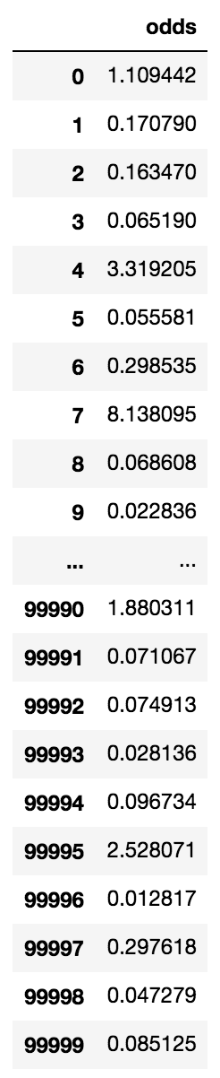
(more specific)
2
Solution
train and predict(LGB and NN)
convert prediction(200k x 200) into odds. We used (9 * p / (1 - p)).

Slide 13
3
Interesting Findings
Removing fake samples is the key of this competition
CountEncoding works even if continuous variable
After scaling, we can handle each var as same var. Unpivot works.
NN is better than LGB
 | Public | Private
LGB | 0.92563 | 0.92436
NN | 0.92640 | 0.92547
LGB:NN=1:1 | 0.92645 | 0.92535
LGB:NN=1:3(our best) | 0.92653 | 0.92552

Slide 14
EOP

